Slide 1
MILLER INDICES
Relation between the lattice constant and the density of crystal material.
Mathematical Problems.
Unit face, Numerical Parameter & Axial units.
Miller indices.
Determination of Miller Indices.
Direction of plane.

Slide 2




Relation between lattice constant & density of crystal material
Consider a unit cell with volume V (cm³). Let ρ (gm/cm³) be the density of the crystal. The weight of the matter in the unit cell is
If n is the number of atoms or molecules per unit cell and M being the atomic (molecular) weight of one atom or molecule. Then the weight of matter in the unit cell is given by
Thus
For a cubic crystal,
Thus

Slide 3
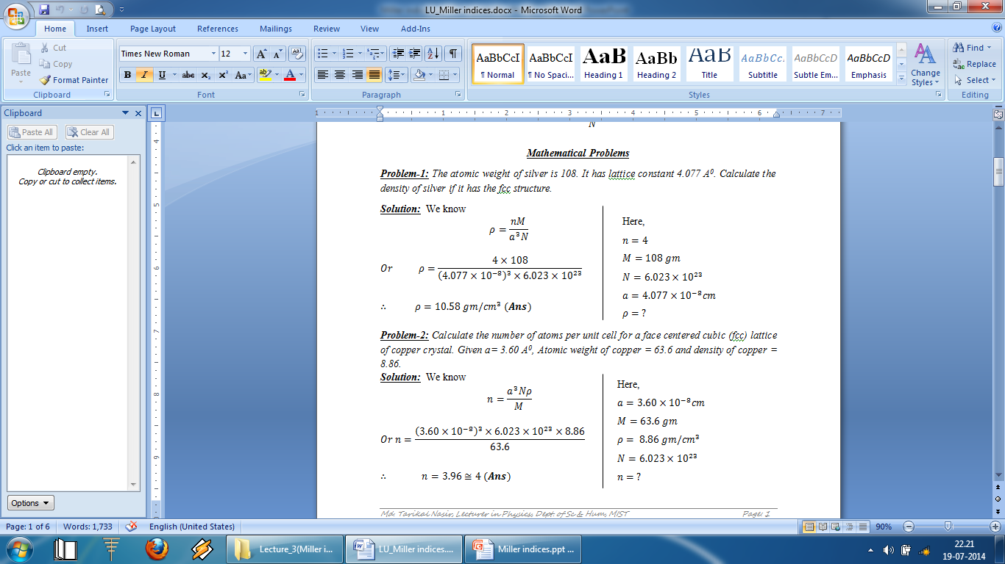
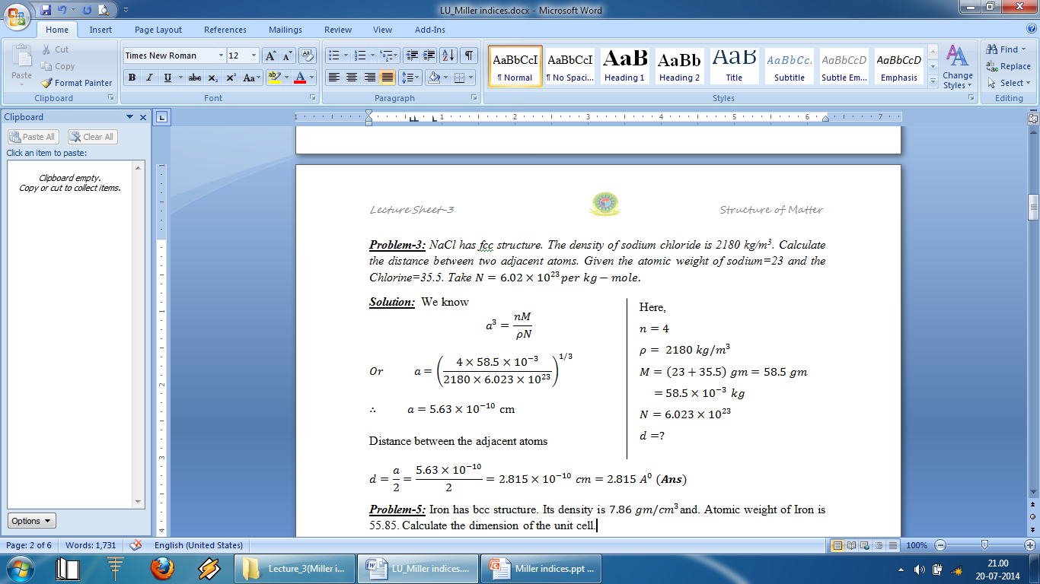

Slide 4
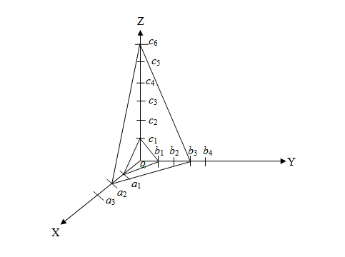
Unit face, Numerical Parameters, Axial Units
The first face intercepts one spacing along each axis whereas second face intercepts two, three and six spacings along the respective axes. The first face is called the unit face which is the face that makes one intercepts on each axes.
The unit face produces three values which are related to each other as 1 : 1 : 1. The second face produces three values 2a, 3b, 6c which are related to each other as 2 : 3 : 6. These figures of 1, 2, 3, and 6 represent the numerical parameters of the faces.
Linear parameters intercepted by the unit face are called the axial units. In the present case, these are a₁, b₁, and c₁ although they are represented generally by a, b, and c along X, Y, and Z axes respectively.

Slide 5
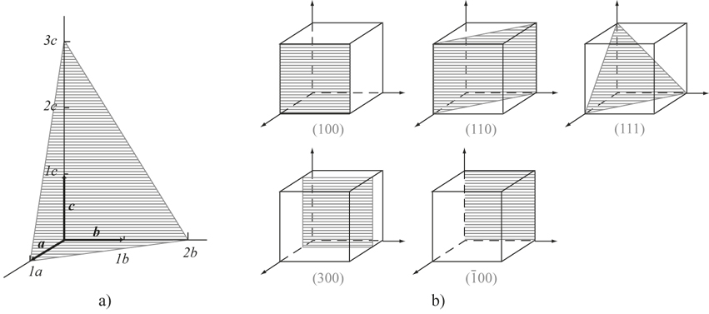
Miller indices
The position and orientation of a crystal plane is determined by three numbers is called Miller indices. It is denoted by (h k l).
Determination of Miller Indices of a plane
Taking any atom in the crystal as the origin and erect coordinate axes from this atom.
Taking intercepts on the axis a, b, c in terms of the lattice constants.
Taking the reciprocal of these intercepts.
Taking the lowest common multiple of the denominator.
Multiplying each reciprocal by the lowest common multiple of the denominator, thus obtained into smallest set of integers. These integers are denoted by h, k, l.
The result is conventionally enclosed in first parenthesis (hkl) which is Miller indices of the plane.

Slide 6

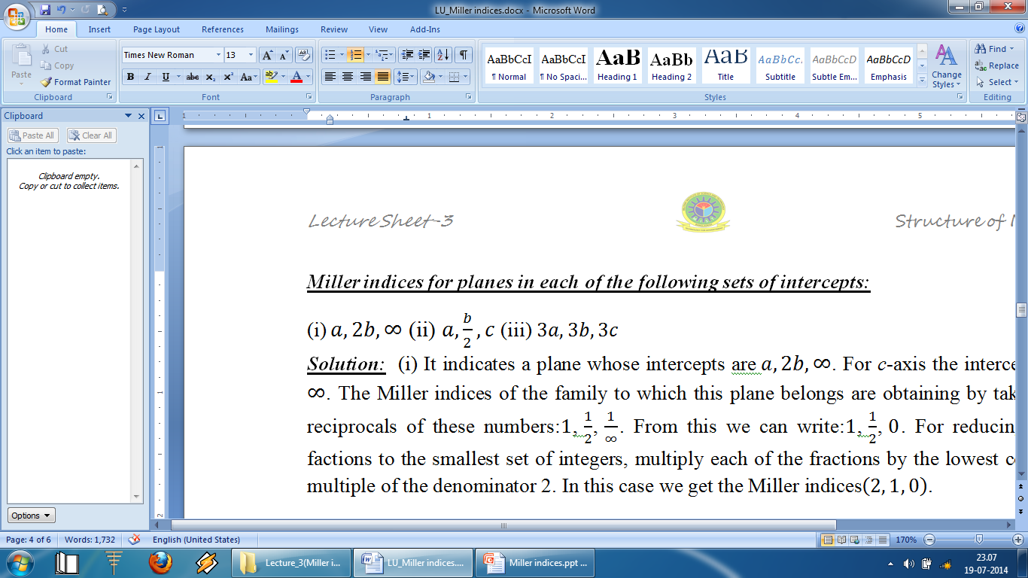
While finding MI of a plane, following points should be kept in mind:
.
When the plane is parallel to one of the coordinate axes, it is said to meet that axis at infinity. Since the miller index for that axis is zero.
If a plane cuts on axis on the negative side of the origin, the corresponding index is negative and is indicated by a bar sign, above the index
Ans:
Ans:
Ans:

Slide 7
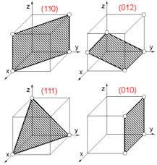
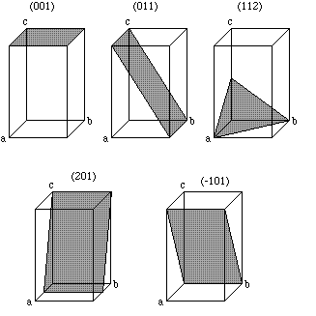
Drawing planes from Miller indices

Slide 8
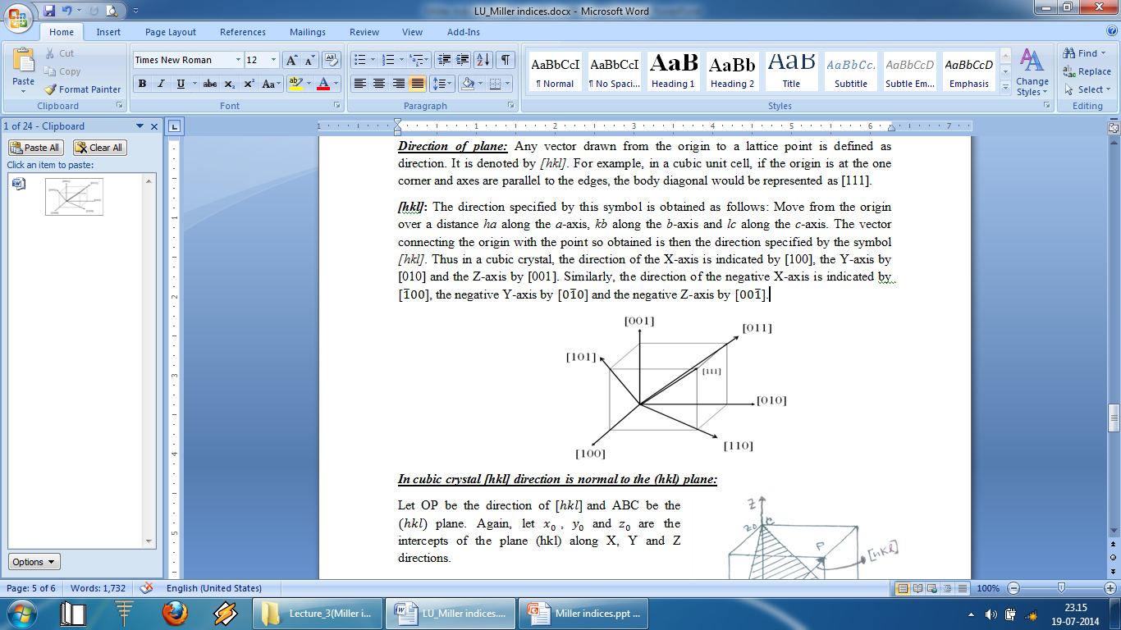
Direction of plane
Any vector drawn from the origin to a lattice point is defined as direction. It is denoted by [hkl]. For example, in a cubic unit cell, if the origin is at the corner and axes are parallel to the edges, the body diagonal would be represented as [111].

Slide 9
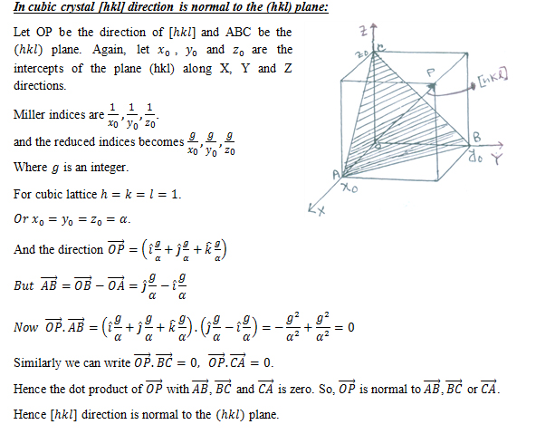

Slide 10
THANK YOU ALL

